Slide 1
Hackathon
Melanoma Tumor Size Prediction:

Slide 2
Overview
Melanoma is the most dangerous type of skin cancer. Globally, in 2012, it newly occurred in 232,000 people. In 2015, there were 3.1 million people with active disease, which resulted in 59,800 deaths. Australia and New Zealand have the highest rates of melanoma in the world. There are also high rates in Northern Europe and North America, while it is less common in Asia, Africa, and Latin America. In the United States melanoma occurs about 1.6 times more often in men than women.

Slide 3
Objective
Building a model to predict tumor size for the given test data

Slide 4
Attributes & Definition
mass_npea: the mass of the area understudy for melanoma tumor
size_npear: the size of the area understudy for melanoma tumor
malign_ratio: ration of normal to malign surface understudy
damage_size: unrecoverable area of skin damaged by the tumor
exposed_area: total area exposed to the tumor
std_dev_malign: standard deviation of malign skin measurements
err_malign: error in malign skin measurements
malign_penalty: penalty applied due to measurement error in the lab
damage_ratio: the ratio of damage to total spread on the skin
tumor_size: size of melanoma_tumor

Slide 5
Train and Test file Anlysis
Target Data is Regression
Decided to implement Regression algorithm
Pre-processing :
No NA fields present in the Train and Test file
Based on the correlation decided to remove some fields
"malign_ratio",
"damage_ratio”

Slide 6
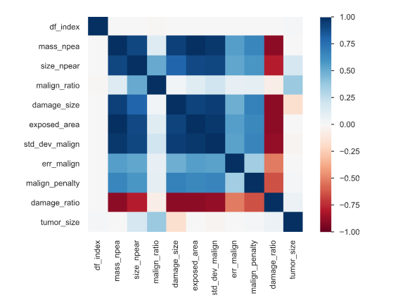
Correlation

Slide 7
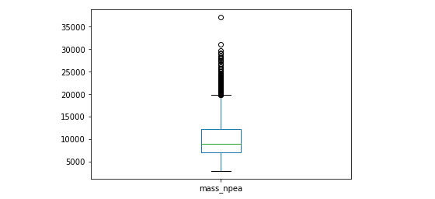
Box Plot of mass_npea

Slide 8
Algorithms Implemented
Implemented with Linear Regression , Decision Tree Regressor, Random Forest Regressor, AdaBoostRegressor, GradientBoostingRegressor, RandomForestRegressor, KNeighborsRegressor with Voting Regressor
And finally with XGBOOST and came up with the score

Slide 9
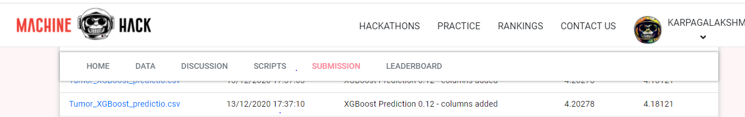
Score in Machine Hack

